Slide 1
Portfolio Assignments for Project: Java and Web Development DLBCSPJWD01
https://github.com/annabanananana/recipe-app
By Anna Jansen von Havighorst Tutor: Christian Remfert IU For the degree of Bachelor of Science in Computer Science

Slide 2
Purpose of the app
Maintain a digital cook book
Add recipes to a data base
Search for recipes in the data base that use certain ingredients

Slide 3
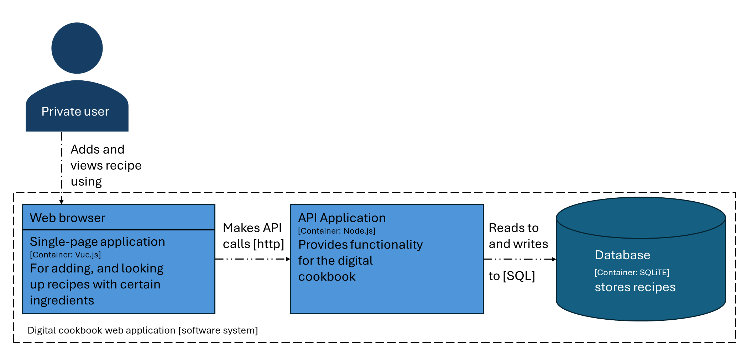
Architecture Diagram

Slide 4
Overview of technology choices
Used technologies for developing the app:
Vue.js
SQLite for database storing the recipes
Node.js

Slide 5
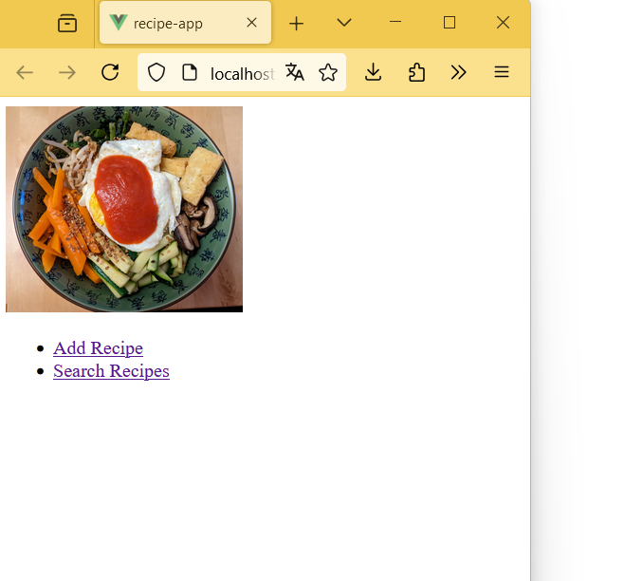
Starting page of the recipe app
From the starting page you can choose to add a recipe or search for a recipe that includes certain ingredients

Slide 6
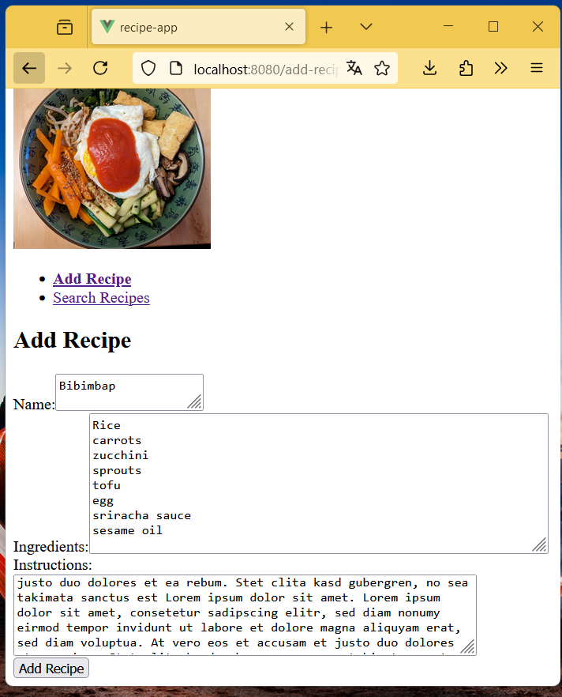
Adding a recipe to the data base
In the Add Recipe view you can enter a name for the recipe, the needed ingredients and useful instructions. The text fields can be adjusted in their size.
By clicking on the „Add Recipe“ button the recipe is added to the data base.

Slide 7
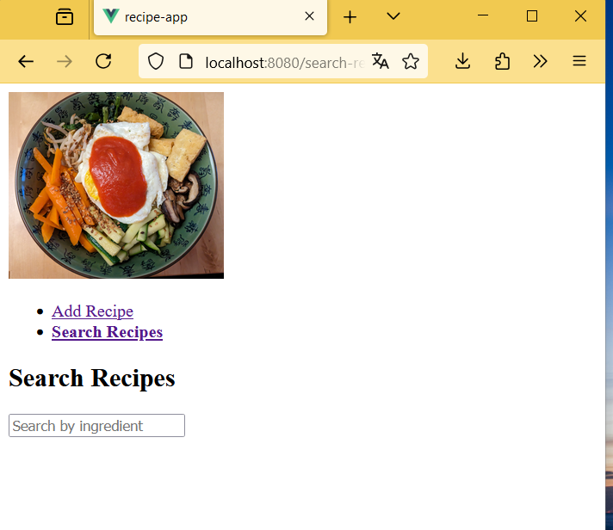
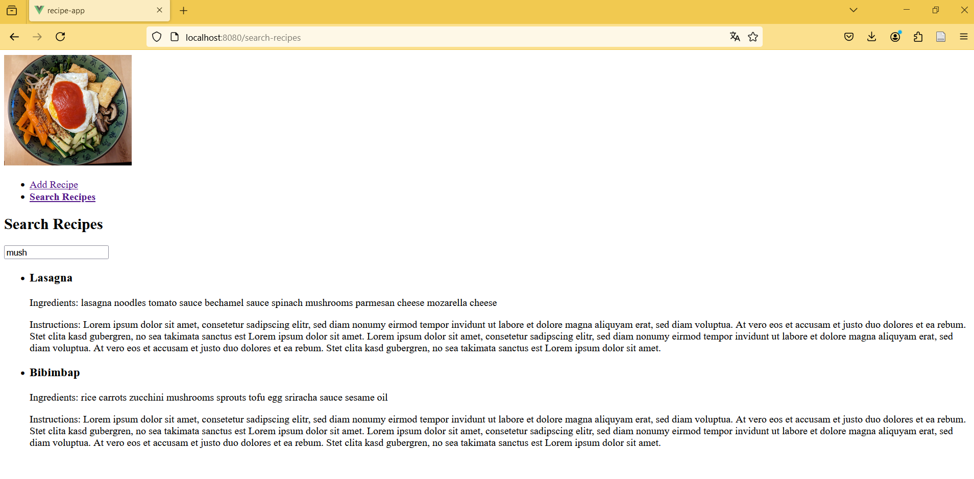
Searching for a recipe in the data base
In the Search Recipe view you can enter an ingredient you want to use and it immediately starts to show you relevant recipes which use the ingredient

Slide 8
Example recipes to use
Pizza
Ingredients: flour yeast water tomato sauce mozarella cheese
Bibimbap
Ingredients: rice carrots egg zucchini mushrooms tofu sprouts sriracha sauce sesame oil
spaghetti with tomato sauce
Ingredients: spaghetti tomatoes onions garlic basil
Rice with vegetables
Ingredients: rice carrots eggplant zucchini onion garlic
lasagna
Ingredients: lasagna noodles spinach mushrooms tomato sauce bechamel sauce parmesan cheese mozarella cheese

Slide 9
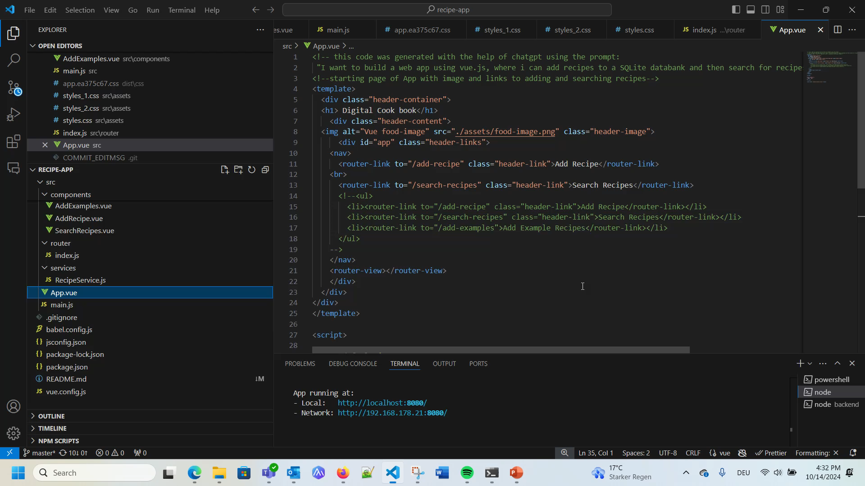
Video running the app

